Slide 1
CS 355/555
Probability and Statistics for CS
Baocheng Geng
Lecture 5, 01/23/2023
CS 355/555 Probability and Statistics for CS

Slide 2







Introduction
Total Probability and Bayes Theorem
1
Introduction
2 Birthday Paradox
3
Total Probability Theorem
Examples
Example 1.14
Example 1.15
Bayes’ Rule
6
Bayes’ Example
7 Next Time
CS 355/555 Probability and Statistics for CS

Slide 3
Copyright Statement
Copyright Statement
Materials prepared for and/or included in this course are protected by copyright law. They are intended to be used only by students enrolled in this course during the current term and should not be further disseminated without prior permission from the course instructor.
CS 355/555 Probability and Statistics for CS

Slide 4
Birthday Paradox
Given two people, what is the probability that they have the same birthday? (ignore leap year birthdays)
What is the probability that they have different birthdays?
365 × 364 364
=
365 × 365 365
CS 355/555 Probability and Statistics for CS

Slide 5
Birthday Paradox
Given three people, what is the probability that two have the same birthday?
What is the probability that they all have different birthdays?
365 364 363 364 363
× × = ×
365 365 365 365 365
CS 355/555 Probability and Statistics for CS

Slide 6
Birthday Paradox
Given four people, what is the probability that two have the same birthday?
What is the probability that they all have different birthdays?
364 363 362
× ×
365 365 365
CS 355/555 Probability and Statistics for CS

Slide 7
Birthday Paradox
Given n+1 people, what is the probability that two have the same birthday?
What is the probability that they all have different birthdays?
364 363 362 365 − n
× × . . .
365 365 365 365
CS 355/555 Probability and Statistics for CS
7/39 10:18

Slide 8
Birthday Paradox
Given n people, what is the probability that two have the same birthday?
What is the probability that they all have different birthdays?
364 363 362 365 − n
× × . . .
365 365 365 365
364!
=
365^{n}(364 − n )!
CS 355/555 Probability and Statistics for CS
7/39 10:18

Slide 9
Birthday Paradox
Calculate odds that there are two with the same birthday:
0.4114 | 20
0.4457 | 21
0.4757 | 22
0.5073 | 23
0.5383 | 24
0.9992 | 70
CS 355/555 Probability and Statistics for CS

Slide 10
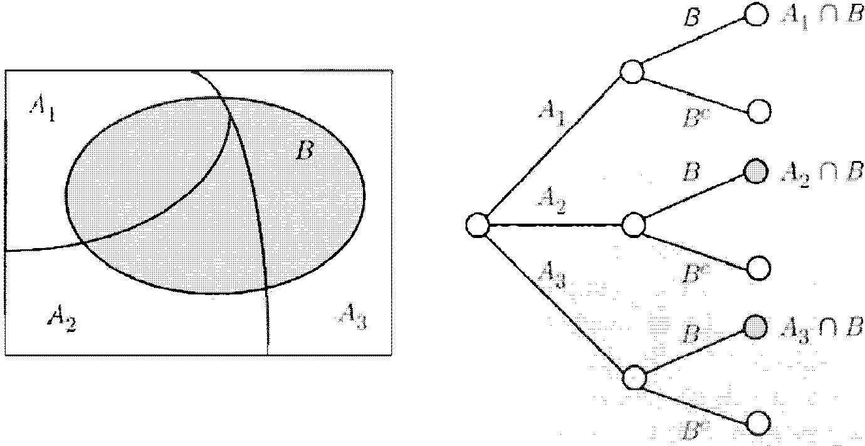
Total Probability Theorem
CS 355/555 Probability and Statistics for CS

Slide 11


Total Probability Theorem
Total Probability Theorem
Let A₁, . . . , A_{n} be disjoint events that partition Ω. Then for B ⊂ Ω
$$Σ_{i=1}^{n}$$
P (B) = P (A ∩ B)
i
$Σ_{i=1}^{n}$
= P (A )P (B|A )
i i
CS 355/555 Probability and Statistics for CS

Slide 12
Total Probability Theorem
Remember
P (A ∩ B)
P (B|A) =
P (A)
so
P (A ∩ B) = P (A)P (B|A)
CS 355/555 Probability and Statistics for CS

Slide 13
Total Probability Theorem
CS 355/555 Probability and Statistics for CS

Slide 14
Example 1.14
I roll a fair four-sided die, with sides number 1,2,3, and 4.
If the result is 1 or 2, roll again and stop. What is the probability that the roll(s) total to at least 4?
CS 355/555 Probability and Statistics for CS
13/39 10:18

Slide 15
Example 1.14
I roll a fair four sided die, with sides number 1,2,3, and 4.
If the result is 1 or 2, roll again. What is the probability that the roll(s) total to at least 4?
Let A_{i} be the event that the first roll is i. Let B be the event that the total is at least 4.
CS 355/555 Probability and Statistics for CS
13/39 10:18

Slide 16
Example 1.14
I roll a fair four sided die, with sides number 1,2,3, and 4.
If the result is 1 or 2, roll again. What is the probability that the roll(s) total to at least 4?
Let A_{i} be the event that the first roll is i. Let B be the event that the total is at least 4.
A_{i} | P (A_{i}) | P (B|A_{i})
1 | 1 4 | 1 2
2 | 1 4 | 3 4
3 | 1 4 | 0
4 | 1 4 | 1
CS 355/555 Probability and Statistics for CS
13/39 10:18

Slide 17
Example 1.14
A_{i} | P (A_{i}) | P (B|A_{i}) | P (A_{i}) × P (B|A_{i})
1 | 1 4 | 1 2 | 1 8
2 | 1 4 | 3 4 | 3 16
3 | 1 4 | 0 | 0
4 | 1 4 | 1 | 1 4
 |  |  | 9 16
CS 355/555 Probability and Statistics for CS

Slide 18
Example 1.14
 | 1 | 2 | 3 | 4
1
2
3
4
CS 355/555 Probability and Statistics for CS

Slide 19
Example 1.14
 | 1 | 2 | 3 | 4
1 |  |  | ✓ | ✓
2 |  | ✓ | ✓ | ✓
3
4 | ✓ | ✓ | ✓ | ✓
CS 355/555 Probability and Statistics for CS
16/39 10:18

Slide 20
Example 1.14
 | 1 | 2 | 3 | 4
1 |  |  | ✓ | ✓
2 |  | ✓ | ✓ | ✓
3
4 | ✓ | ✓ | ✓ | ✓
# 9
P (≥ 4) = =
16 16
CS 355/555 Probability and Statistics for CS
16/39 10:18

Slide 21
Example 1.15
Alice is taking a probability class. At the end of each week she is caught up or behind.
If she is up to date at the beginning of the week, she remains up to date at the end with probability .8.
If she is not up to date at the beginning of the week, she becomes up to date at the end with probability .4.
The probability that she is up at the end of first week is .8.
What is the probability she is up to date after three weeks?
CS 355/555 Probability and Statistics for CS

Slide 22
Example 1.15
Let U_{i} and B_{i} be the probability that she is up to date or behind at week i.
P (U₃) = P (U₂)P (U₃|U₂) + P (B₂)P (U₃|B₂)
= P (U₂) × .8 + P (B₂) × .4
CS 355/555 Probability and Statistics for CS

Slide 23
Example 1.15
P (U₂) = P (U₁)P (U₂|U₁) + P (B₁)P (U₂|B₁)
= P (U₁) × .8 + P (B₁) × .4
CS 355/555 Probability and Statistics for CS
19/39 10:18

Slide 24
Example 1.15
P (U₂) = P (U₁)P (U₂|U₁) + P (B₁)P (U₂|B₁)
= P (U₁) × .8 + P (B₁) × .4
= .8 × .8 + .2 × .4 = .64 + .08 = .72
CS 355/555 Probability and Statistics for CS
19/39 10:18

Slide 25
Example 1.15
Let U_{i} and B_{i} be the probability that she is up to date or behind at week i.
P (U₃) = P (U₂)P (U₃|U₂) + P (B₂)P (U₃|B₂)
= .72 × .8 + P (B₂) × .4
CS 355/555 Probability and Statistics for CS

Slide 26
Example 1.15
P (B₂) = P (U₁)P (B₂|U₁) + P (B₁)P (B₂|B₁)
= P (U₁) × .2 + P (B₁) × .6
CS 355/555 Probability and Statistics for CS
21/39 10:18

Slide 27
Example 1.15
P (B₂) = P (U₁)P (B₂|U₁) + P (B₁)P (B₂|B₁)
= P (U₁) × .2 + P (B₁) × .6
= .8 × .2 + .2 × .6 = .16 + .12 = .28
CS 355/555 Probability and Statistics for CS
21/39 10:18

Slide 28
Example 1.15
Let U_{i} and B_{i} be the probability that she is up to date or behind at week i.
P (U₃) = P (U₂)P (U₃|U₂) + P (B₂)P (U₃|B₂)
= .72 × .8 + .28 × .4 = .688
CS 355/555 Probability and Statistics for CS

Slide 29
Example 1.15
Do this in Excel:
.8 | .2
=A1*.8 + B1*.4 | =A1*.2 + B1*.6
CS 355/555 Probability and Statistics for CS
23/39 10:18

Slide 30
Example 1.15
Do this in Excel:
.8 | .2
=A1*.8 + B1*.4 | =A1*.2 + B1*.6
=A2*.8 + B2*.4 | =A2*.2 + B2*.6
CS 355/555 Probability and Statistics for CS
23/39 10:18

Slide 31
Example 1.15
What happens to Alice after 8 weeks?
0.8 | 0.2
0.72 | 0.28
0.688 | 0.312
0.6752 | 0.3248
0.67008 | 0.32992
0.668032 | 0.331968
0.6672128 | 0.3327872
0.66688512 | 0.33311488
CS 355/555 Probability and Statistics for CS

Slide 32
Bayes’ Rule
Thomas Bayes
c. 1701 – 7 April 1761 English statistician, philosopher, and Presbyterian minister who is known for formulating a specific case of
the theorem that bears his name: Bayes’ theorem.
CS 355/555 Probability and Statistics for CS

Slide 33
Bayes’ Rule
Bayes’ Rule
P (B | A)P (A)
P (A | B) =
P (B)
CS 355/555 Probability and Statistics for CS

Slide 34
Bayes’ Rule
Using Law of Total Probability
P (A)P (B | A)
P (A | B) =
P (A)P (B|A) + P (A^{C} )P (B|A^{C} )
Bayes’ Rule
CS 355/555 Probability and Statistics for CS

Slide 35

Bayes’ Rule
Generalizing
Bayes’ Rule
P (B | A )P (A )
P (A | B) =
i i
i
$Σ_{i}^{n}$P (B|A_{i})
CS 355/555 Probability and Statistics for CS

Slide 36
Example 1.18¹
Given a virus and a test for the virus, suppose it is correct 95% of the time.
That is, if A has the virus, the test says A has it 95% of the time.
If A does not have the virus, the test says A does not have it 95% of the time.
A random person drawn from the population has the virus with probablity .001.
¹Note the book was published in 2002
CS 355/555 Probability and Statistics for CS
29/39 10:18

Slide 37
Example 1.18¹
Given a virus and a test for the virus, suppose it is correct 95% of the time.
That is, if A has the virus, the test says A has it 95% of the time.
If A does not have the virus, the test says A does not have it 95% of the time.
A random person drawn from the population has the virus with probablity .001.
If person A takes the test and the test is positive, what is the probability that A has the virus?
¹Note the book was published in 2002
CS 355/555 Probability and Statistics for CS
29/39 10:18

Slide 38
Example 1.18
If A has the virus, the test says A has it 95% of the time.
False negative rate 5%.
CS 355/555 Probability and Statistics for CS
30/39 10:18

Slide 39
Example 1.18
If A has the virus, the test says A has it 95% of the time.
False negative rate 5%.
If A does not have the virus, the test says A does not have it 95% of the time.
False positive rate 5%
CS 355/555 Probability and Statistics for CS
30/39 10:18

Slide 40
Example 1.18
Let’s apply Bayes’ rule.
P (A)P (B | A)
P (A | B) =
P (A)P (B|A) + P (A^{C} )P (B|A^{C} )
We need:
P(A)
P (B|A)
P (A^{C} )
P (B|A^{C} )
CS 355/555 Probability and Statistics for CS

Slide 41
Example 1.18
Let’s apply Bayes’ rule.
P (A)P (B | A)
P (A | B) =
P (A)P (B|A) + P (A^{C} )P (B|A^{C} )
We need:
P(A) | .001
P (B|A) | .95
P (A^{C} ) | .999
P (B|A^{C} ) | .05
CS 355/555 Probability and Statistics for CS

Slide 42
Example 1.18
P(A) | .001
P (B|A) | .95
P (A^{C} ) | .999
P (B|A^{C} ) | .05
.001 × .95
P (A | B) =
.001 × .95 + .999 × .05
CS 355/555 Probability and Statistics for CS
33/39 10:18

Slide 43
Example 1.18
P(A) | .001
P (B|A) | .95
P (A^{C} ) | .999
P (B|A^{C} ) | .05
.001 × .95
P (A | B) =
.001 × .95 + .999 × .05
.00095 .00095
P (A | B) =
=
= .0187
.00095 + .04995 .0509
CS 355/555 Probability and Statistics for CS
33/39 10:18

Slide 44
Example 1.9
100 infections
100,000 people
99000 No infection

Slide 45
Example 1.9
95 test positive
100 infections
5 test negative
100,000 people
99000 No infection

Slide 46
Example 1.9
95 test positive
100 infections
5 test negative
100,000 people
9950 No infection, test positive
99000 No infection
94050 No infection, test negative
CS 355/555 Probability and Statistics for CS

Slide 47
Example 1.9
95 test positive
100 infections
5 test negative
100,000 people
4995 No infection, test positive
99900 No infection
94905 No infection, test negative
Suppose test positive: P (infected|Positive) = ⁹⁵ = 1.87%
95+4995
Suppose test negative: P (not infected|Negative) = ⁹⁴⁹⁰⁵ = 99.9%
94905+5
CS 355/555 Probability and Statistics for CS

Slide 48
Bayes’ Rule
Bayes’ Rule
P (A)P (B | A)
P (A | B) =
P (A)P (B|A) + P (A^{C} )P (B|A^{C} )
.001 × .95
P (A | B) =
.001 × .95 + .999 × .05
If P (A) is small and false positive is not small, then the fraction is a small number divided by a small number plus a big number.
CS 355/555 Probability and Statistics for CS

Slide 49
Next Class
Read Chapter 1, 1.5 ppg 34 - 43
CS 355/555 Probability and Statistics for CS
39/39 10:18

